Slide 1
Area of Trapezoid
G1. Find the area of right triangles, other triangles, special quadrilaterals, and polygons by composing into rectangles or decomposing into triangles and other shapes; and apply these techniques in the context of solving real-world and mathematical problems.

Slide 2
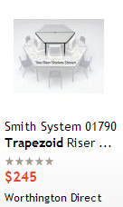
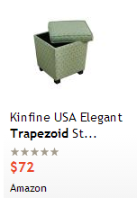
Trapezoid Furniture

Slide 3
Finding the Area of a Trapezoid

Slide 4
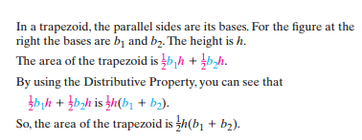
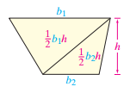
Why is the formula $A=\frac{1}{2}h(b_{1}+b_{2})$?

Slide 5
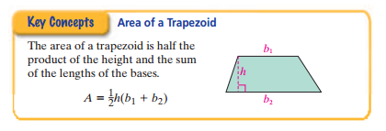
The area of a trapezoid can also be found by getting the sum of the areas of the two triangles that make up the trapezoid.

Slide 6
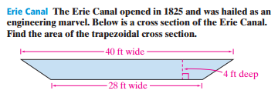
Problem 1

Slide 7
Problem 2

Slide 8
Problem 3

Slide 9
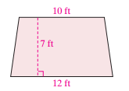
Problem 4

Slide 10
Problem 5

Slide 11
Problem 6

Slide 12
Problem 7

Slide 13
Problem 8

Slide 14
Problem 9

Slide 15
Problem 10

Slide 16
Lesson Quiz

Slide 17
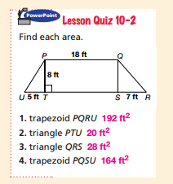
parallelogram PQST
triangle PTU
triangle QRS
trapezoid PQRU
trapezoid PQSU

